Slide 1
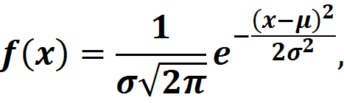
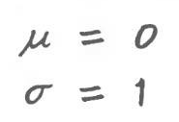
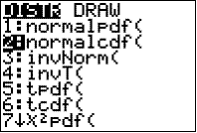
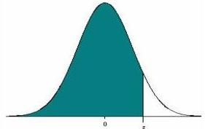



Empirical and Chebyshev Rules
Chapter 5 Part 3
$$normalcdf(−∞,z)$$
$$P(Z≤z)$$
$$z$$

Slide 2
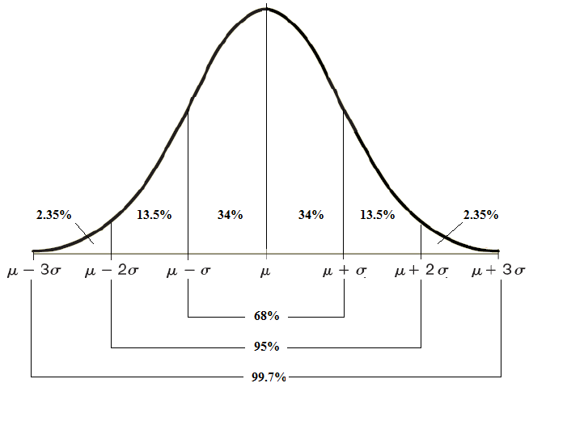

Empirical Rule
The total area under any normal curve from -∞ to +∞ always add up to 1
The following probabilities are fixed in any normal distribution. This is known as the Empirical rule
The portion of the area under the curve within a given interval represents the probability that the RV lie in that interval
$$P\left(μ−σ≤X≤μ+σ\right)=0.6827$$
$$P\left(μ−2σ≤X≤μ+2σ\right)=0.9545$$
$$P\left(μ−3σ≤X≤μ+3σ\right)=0.9973$$
Notes:
You can easily compute the probabilities using calculator, just follow standardization first
$$P\left(μ−σ≤X≤μ+σ\right)=P\left(−1≤\frac{X−μ}{σ}≤1\right)=P\left(−1≤Z≤1\right)=0.6827$$

Slide 3
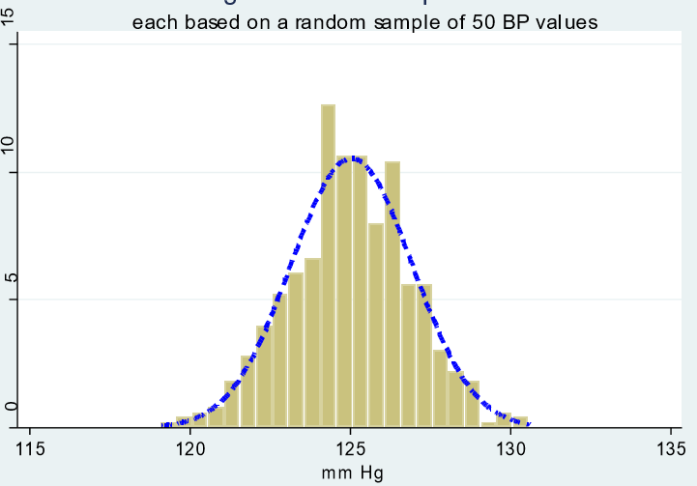
Example
The following histogram that shows Blood Pressure of 30-35 yo men, is created from a random sample of n = 50 healthy men.
μ = 125.03 mmHg
σ = 1.89 mmHg
A 99% Empirical Rule interval then is (μ-3σ , μ+3σ)= (119.36 , 130.70)
If a 30-35 yo man’s BP fall outside this interval, there is a high chance that stm is wrong with him because this happens in only nearly 1% (1 out of 100) men (30-35 yo).
Notes:
The importance of Empirical Rule is in its real-life applications to detect unlikely incidents

Slide 4
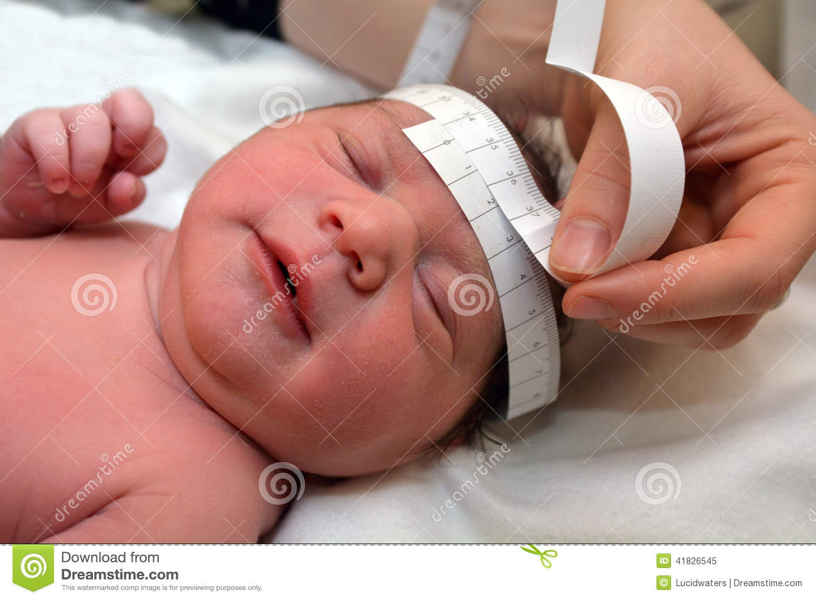
Example
Head Circumference of Newborn Girls: Past results from the National Health Survey suggest that the head circumferences of two-month old girls have a mean of 40.05 cm and a standard deviation of 1.64 cm.
a) Use the Empirical Rule to find the minimum and maximum 95% “usual” head Circumferences interval.
b) Determine whether a circumference of 42.6 cm is considered “unusual.”

Slide 5
Example
Heights of 18-year-old males have a bell-shaped distribution with mean 69.6 inches and standard deviation 1.4 inches.
About what proportion of all such men are between 68.2 and 71 inches tall?
What interval centered on the mean should contain about 95% of all such men?

Slide 6
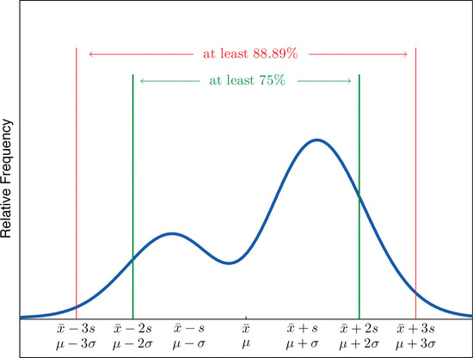
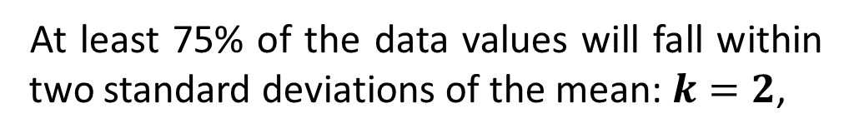
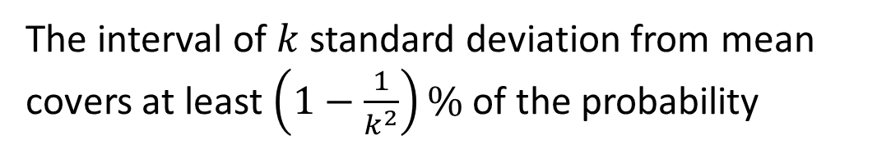


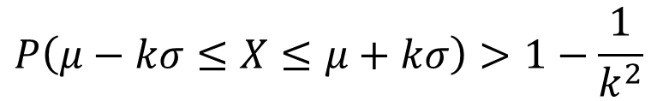
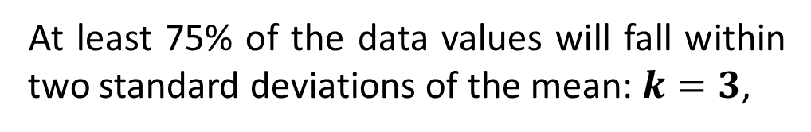
Chebyshev Rule
For a continuous random phenomenon with Non-normal distribution, we use the following intervals to build confidence intervals:
$$P\left(μ−kσ≤X≤μ+kσ\right)>1−\frac{1}{k^{2}}$$
The interval of $k$ standard deviation from mean covers at least $\left(1−\frac{1}{k^{2}}\right)\%$ of the probability
At least 75% of the data values will fall within two standard deviations of the mean: $k=2$,
$$P\left(μ−2σ≤X≤μ+2σ\right)>1−\frac{1}{2^{2}}=0.75$$
At least 75% of the data values will fall within two standard deviations of the mean: $k=3$,
$$P\left(μ−3σ≤X≤μ+3σ\right)>1−\frac{1}{3^{2}}=0.89$$
Notes:
It doesn’t work for k=1

Slide 7
Example
Use to Chebyshev Rule to answer
a) At least what percentage of the observed data fall within three standard deviation of the mean.
b) At most what percentage of the observed data fall outside four standard deviation of the mean.
c) A left-skewed distribution has a mean of 4.99 and a standard deviation of 3.13. Find the interval that you would expect to include 75% of the observations.
d) Suppose our observed data has mean 100 and standard deviation 18. Approximately what percentage of data is expected to fall between 64 and 136?

Slide 8
Examples
Height of women have a skewed distribution with a mean of 163 cm and a standard deviation of 6 cm. What percentage of women have heights between 145 cm and 181 cm?

Slide 9
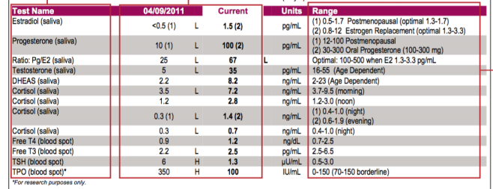
Real-life
The following is a sample urine and blood test results and normal/abnormal intervals for each test.
How trustworthy are the results? Discuss.
Notes:
Is it based on normal curve?

Slide 10


Practice Problems Part 1
1. The mean weekly income of employees at XYZ Company is $550 and the standard deviation is $75. According to the Chebyshev’s Theorem, at least what percent of the incomes lie within 1.5 standard deviation of the mean?
2. The mean weight of a package handled by Speedy Delivery Inc. is 18 lbs with a standard deviation of 7 lbs. Using Chebyshev’s Theorem, at least what percentage of packages will lie within 2 standard deviations of the mean?
3. The average number of hours worked by GRCC Business Lab employees is 22 hours with a standard deviation of 7 hours. According to the Empirical Rule, 95% of the employees’ hours worked will fall between what two values?
Notes:
Answers are provided in Ch5 Practice Problem Solutions.

Slide 11

Practice Problems Part 1
4. A professor was looking to purchase a new pair of skis heading into the winter. His banker spouse was supportive but was interested in how much said Professor intended to spend. The professor said “Eh, should be somewhere around $250.” This did not satisfy the Banker who requested additional information. The Professor went out and did some research and found that the mean cost of the skis he was looking for was $275 and the standard deviation was $50. According to the Empirical rule answer the following:
a. Approximately 68% of all ski prices are between what two values?
b. Approximately 95% of all ski prices are between what two values?
c. Approximately 99%+ of all ski prices are between what two values?
Notes:
Answers are provided in Ch5 Practice Problem Solutions.

